Slide 1
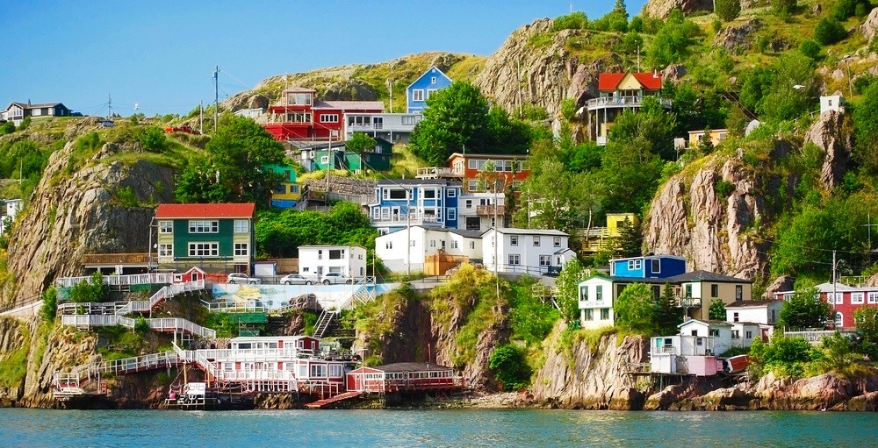
Exploring Towns in Newfoundland
Capstone Project

Slide 2
Introduction
In Newfoundland, there are a variety of different places you should visit.
Each town has many places to visit from restaurants, marinas, and Scenic avenues.
What City should you stay in?

Slide 3
Data Sources
Newfoundland town and city names and area: https://en.wikipedia.org/wiki/List_of_municipalities_in_Newfoundland_and_Labrador
Geographical locations of towns and cities: ArcGIS
Geospatial data – Common venues in each town and city: Foursquare

Slide 4
Methodology
Web Scraping
List of Towns/Cities
Area of each Town/City
Geocoding
Longitude and Latitude
Foursquare API
Request for 100 most common venues
Engineering
Convert variables to numerical values
Find top 10 most common venues
Learning
K-means clustering
Number of clusters using elbow method

Slide 5
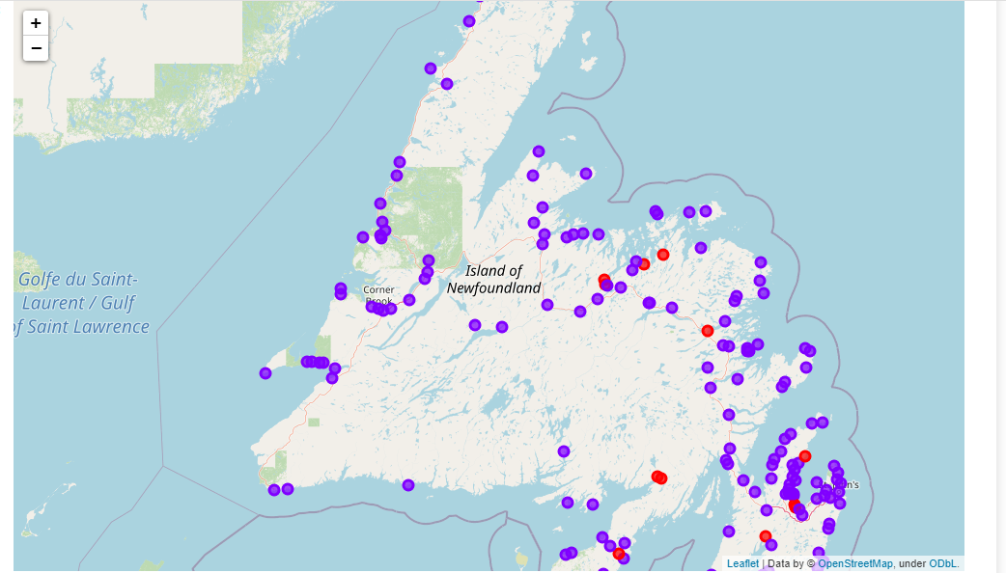
Results and Discussions
Cluster 1 (red)
Convenience Stores, ATMs, Fishing spots are very common
Cluster 2 (purple)
Coffee shops, Restaurants, Marinas very common

Slide 6
Conclusion
The findings of this study gives a good starting point to consider the ideal town/city to stay
Cluster 1 provides Convenience stores and ATMs, but not much else
Cluster 2 provides restaurants and coffee shops and other neat places to visit.
With further data analysis we could incorporate many other factors such as hospitals and schools for people looking to move to Newfoundland

Slide 7
References
Slide 1 image: https://images.dailyhive.com/20180918102924/shutterstock_144308257.jpg

